Slide 1



Slide 2
"Current developments in hardware technology are making it economically attractive to run many physical processors in parallel“ - Lewis Carroll, 1973
Notes:
41 years ago.
Computer scientists knew parallelism was the key to software development before most of you were born

Slide 3




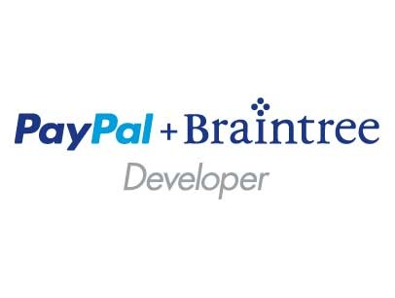






Notes:
Please take a moment and thank our Principal, Platinum and Gold Sponsors.

Slide 4
Canonical Arch for processing events
Producers
Collection
Ingestor (broker)
Transformation
Long term storage
Presentation and action
Real-time analytics (Storm/Orleans)
Applications
Cloud Gateways (WebAPIs)
Scalable event Broker
Azure Storage
Web/thick client dashboards
-
Your are here
HD Insight
Devices
Field Gateways
External data sources
Search and query
Azure Event Hub – IoT at Scale
w/ Brent Stineman
Build a time machine to attend
HDInsight and Internet of Things
w/ Tony Guidici
Tuesday, 2:30pm, Tamarind
Batching/storage adapters
Data analytics (Excel)
Notes:
Event Processing is just one possible Internet of Things pattern. But this pattern is fairly predictable.
We start with producers that are “publishing” events. These events are optionally collected by various sources (2), be they gateway hubs (controllers) or service APIs. These collectors feed the events to an ingestion broker (3) which in turn is consumed by one or more transformation engines (4). These engine then take all disjointed “data” from the events and change it into actionable information. The data/information is then persisted into some type of storage (5), and finally it is made available to be presented in some form that allows us to take action on it (6).
In this session, we’ll be talking about the transformation stage. In particular, we’re going to look at how we can process massive quantities of data in a reliable, scalable way.
If you missed the Azure Event Hubs session, you can either build a time machine and listen to Brent’s talk, or you can check out a recent episode on the MS Dev Show podcast.

Slide 5
Jason Young
Microsoft Sr. Program Manager & Evangelist
@ytechie
ytechie.com
MsDevShow.com
https://github.com/ytechie/orleans-conference-demo
Notes:
Co-host of the MS Dev show, I have stickers for anyone that wants one.
Subscribe to the podcast, help us hit our goal of 50k downloads by next July.
All of my code and this presentation is available on GitHub

Slide 6


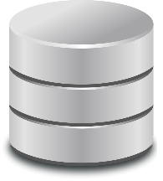
Frontends
Middle Tier
Storage
Notes:
Here is a traditional web, app, DB design. This is increasingly a relic. It was designed in a different era.
Problems:
Storage is a bottleneck here. It’s high latency and low throughput.
What if our middle tier can’t keep up?
What happens if our datacenter goes down, or, more likely, connectivity is lost
How are failures handled?
That’s ok. I’m here to help.

Slide 7
Scalability
Availability
Manageability
Feasibility
Scalability
Manageability
Availability
Feasibility
Notes:
When evaluating architectures, these are typically the attributes we’re looking at.
Scalability: the ability to add additional capacity efficiently
Availability: ability to provide value in the face of underlying failures
Manageability: ability to understand health and performance of the system, do upgrades, make changes
Feasibility: ability to deliver and maintain the system on time and on budget

Slide 8
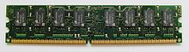

Frontends
Middle Tier
Cache
Storage
Notes:
Let’s throw some cache at it. And traffic manager. And a queue. Now we’re cooking with cloud!
We actually did make some massive improvements. BUT:
Lost our storage semantics
Direct path end-to-end through the system is highly coupled
No load leveling
Shared resources between workloads – the middle tier is processing short-term and long-term workloads
Think about how you can make a 200 response mean data “received” instead of “processed”

Slide 9

Waking up the Chief
Skill & Ranking
Cheat Detection
Presence & Matchmaking
Challenges & Unlockables
Game History
Profile
User Generated Content
Content Management Service
Notes:
Made $300 million opening weekend
More than 1 million people playing on xbox live within 24 hours of release

Slide 10
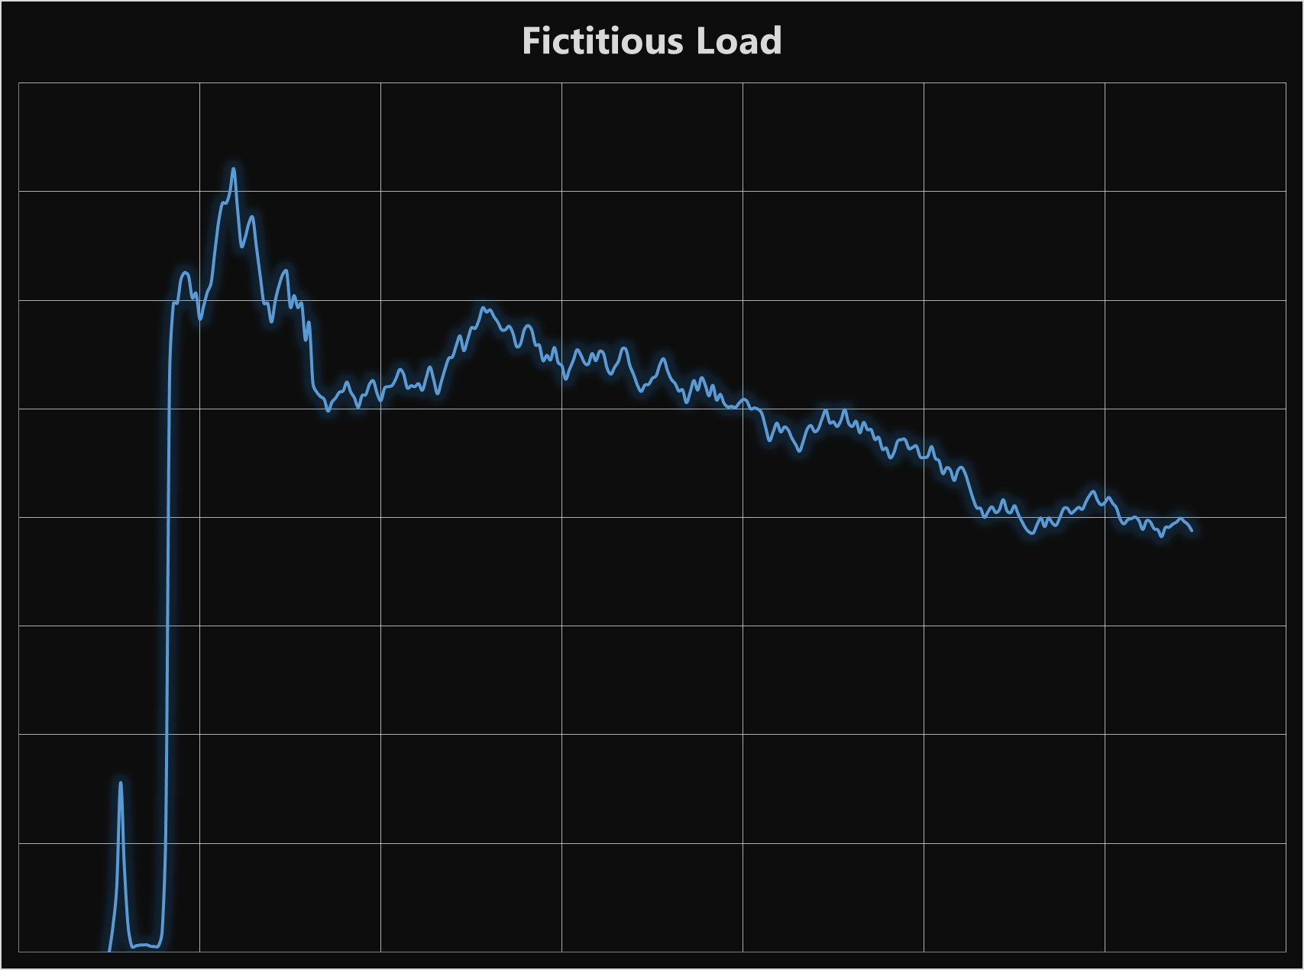
Patterns of a big game launch
Huge traffic spike on launch
Downtime at launch is really bad
Also spikes on weekends and holidays
Load steadies out over time

Slide 11
Frontends
Storage
Magic!
Orleans!

Slide 12
Erlang
ATM Switch
99.9999999% reliability (9 nines) (31 ms. year!)
Notes:
How does Erlang achieve the impossible

Slide 13
Orleans App Tier
Stateful
Scalable
Fault tolerant
Easy
Notes:
Orleans gives us a simple programming model, that gives us all of these things as long as we follow the rules.
Orleans is an easy programming model, which means more code and less bugs.

Slide 14
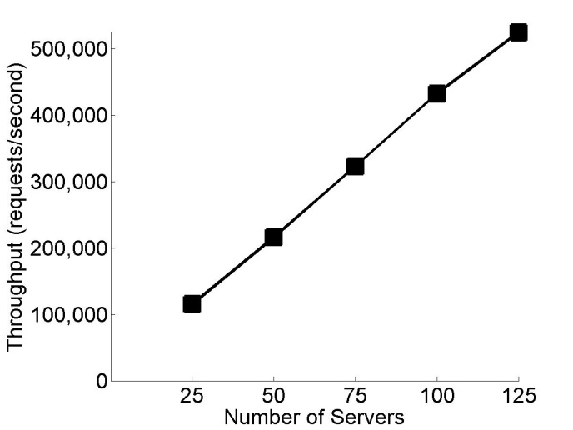
Scalability by Default
Test Lab Numbers
Notes:
Near linear scaling to hundreds of thousands of reqs/sec
Efficient resource usage
Location transparency simplifies scaling
Easily adjust scale over time
Performance expectations Using X-Large VMs (8 CPU Cores / 14 GB RAM) on Microsoft Azure, with one silo per VM (https://github.com/OrleansContrib/DesignPatterns):
A grain will handle a maximum of 1,000 requests per second.
A silo will handle a maximum of 10,000 requests per second.
A silo will hold 100,000 active grains.

Slide 15
“Orleans” was built for…
Scenarios
Social graphs
Mobile backend
Internet of things
Real-time analytics
‘Intelligent’ cache
Interactive entertainment
Common characteristics
Large numbers of independent actors
Free-form relations
High throughput/low latency
These generally dictate stateful compute
Fine-Grained partitioning is natural
Cloud-based scale-out & elasticity
Much broader developer audience

Slide 16
Actor Grain
Simple
Immortal
Async
Stateful
Notes:
The concept of a grain in Orleans is what enables it’s power.
This is based on the actor model from 1973
Erlang is a well known implementation of the actor model
Simple: A grain is easy to write. In fact, it’s barely different than a POCO.
Single threaded
You don’t know/care where the grain resides
ID just be a long or a GUID
Immortal: Grains last forever. When you work with a grain, you’re working with an instance. Works like virtual memory.
Activation is transparent
Async: All code must be async, this is key to Orleans scheduling
Async is a key to modern performance gains
Stateful: Use state in-memory, automatic and custom persistence
Separates storage concerns

Slide 17
Grain interfaces
Marker interface to indicate grain interfaces
public interface IHello : IGrain
{
Task<string> SayHello(string greeting);
}
All grain interface methods must be asynchronous

Slide 18
Implementing the grain type
public class HelloGrain : GrainBase, IHello
{
Task<string> SayHello(string greeting)
{
var resp = "You said: '" + greeting + "', I say: Hello!";
return Task.FromResult(resp);
}
}

Slide 19
Starting a Silo
Notes:
We can run this on-premesis or in the cloud
Install the Orleans SDK
Verify permissions to /sdk/binaries/applications
I have a local console project to start a silo and connect to it

Slide 20
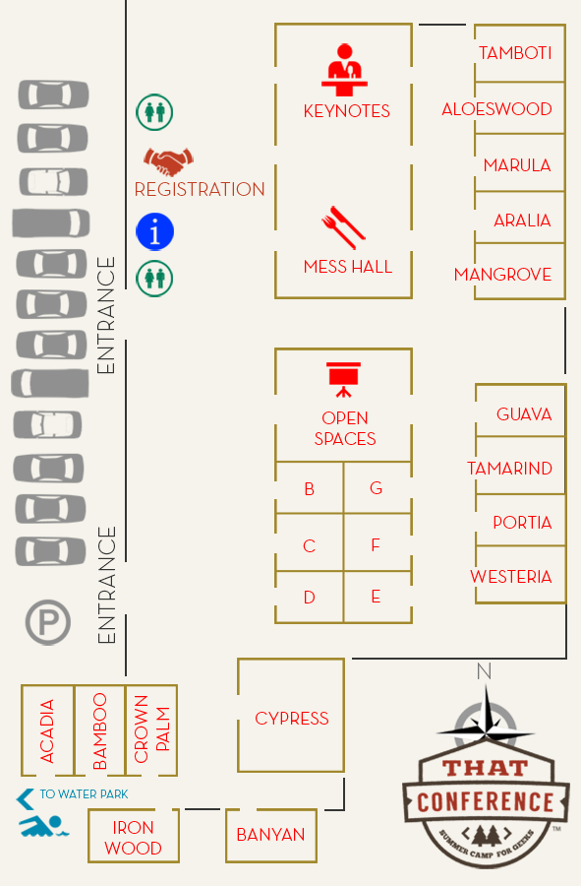
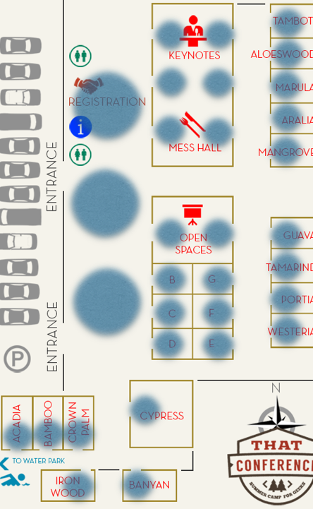
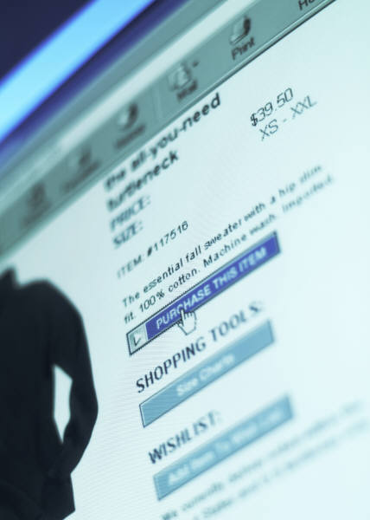


Notes:
This session is part of a narrative. An attempt to take some Internet of Things problems and put them into a relatable context. That contact is a solution for tracking activity at a technical conference, and transforming that data into usable information.
We start with our conference venue (1). Then we add a web site (2), with users registering, and clicking on sessions/speakers. Next, we have vendors (3) that are scanning attendee badges to get their contact info from the conference organizer. Add to that the conference’s mobile app (4), and social media. And as if there wasn’t enough data sources, we’re also going to scatter “proximity sensors” around the event site (5) that can detect the “smart badges” that the attendees are wearing.
All together, this is a lot of events that provide valuable information to the conference organizer (which sessions are full, where are attendees congregating, etc..), attendees (my friends are where, and interested in what), and vendors (which booth locations are more visited, which attendees stopped at my particular booth vs walking by). But there are some challenges… (next slide)
Twitter Logo – used under creative commons from, http://www.gizmos.es/programas-y-aplicaciones/twitter-ya-tiene-200-millones-de-usuarios-activos-al-mes.html
WhatsApp – used under creative commons from, http://www.dennisbaaten.com/2012/07/27/whatsapp-versleutelt-berichtenverkeer-in-stilte/

Slide 21
Grain Code
Notes:
Let’s take a look at a sample grain
IntroducingAGrain
CheckInDemo

Slide 22
Designing Grains
What do you know?
What do you want to know?
Notes:
This is not a database

Slide 23
Ingestion
Notes:
Let’s pull sensor data from eventhub

Slide 24
Azure Deployment
Worker roles host silos
Web roles host client
Notes:
Orleans was built for Azure. By adding Azure, we get:
On-demand machines
Shared storage

Slide 25
Advanced Features
Reminders
Reentrant Grains
Notes:
This is not a database

Slide 26


Get started
Visit azure.microsoft.com
Azure Event Hub – IOT at Scale
w/ Brent Stineman
Monday@1:00pm, Guava
Massively Parallel Azure Systems
w/ Jason Young
Tuesday@10:30am, Aralia
HDInsight and Internet of Things
w/ Tony Guidici
Tuesday, 2:30pm, Tamarind
Notes:
Thank you for attending my session. I hope I was able to excite you about the possibilities with Event Hub. If you found this session interesting and would like to learn more about our conference tracking scenario, please check out the companion sessions by Jason and Tony.
Questions?

Slide 27

Notes:
Next year’s date.

Slide 28
References
Using Orleans to Build Halo 4’s Distributed Cloud Services in Azure
Building Big: Lessons Learned from Azure Customers
Orleans on Codeplex (samples, docs, etc)
Concurrency Oriented Programming in Erlang

